Slide 1
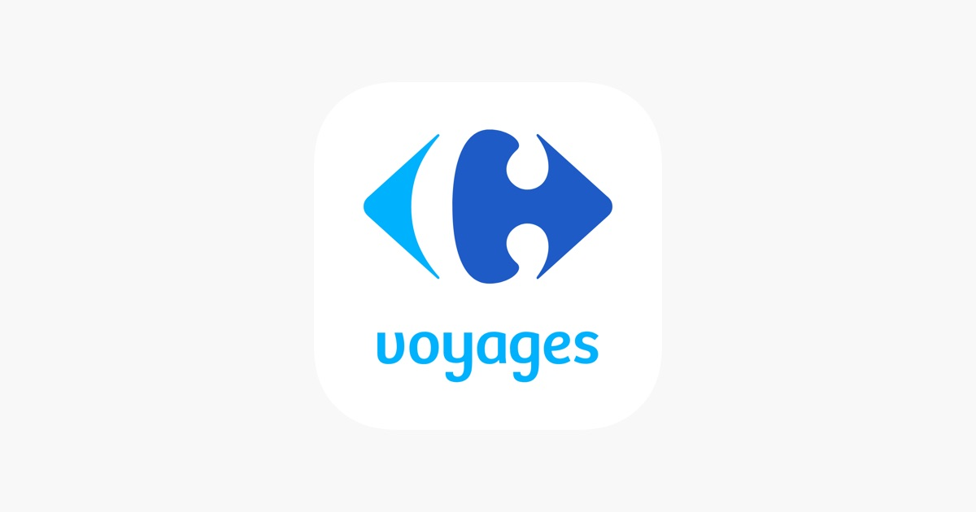
Carrefour Voyages Growth Strategy
Network Performance & Insights for 2024-2025
Samuel-Sacha-Clotilde
Group 7

Slide 2
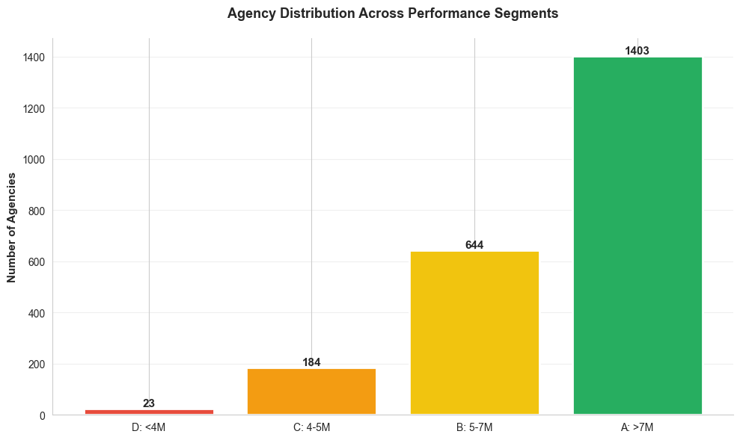
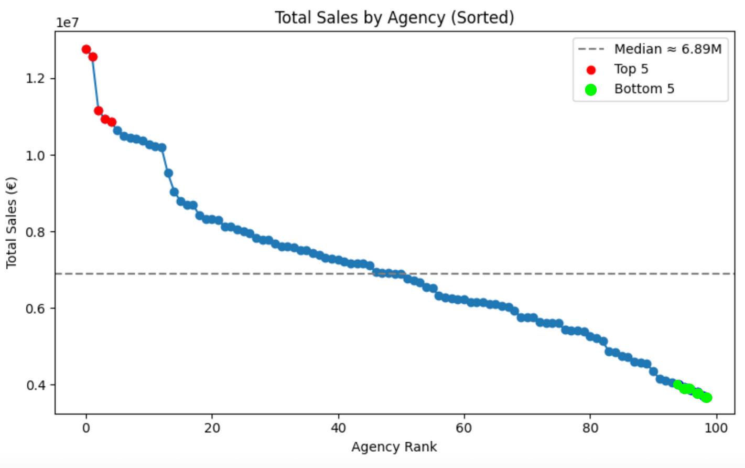

x 2
Revenue Disparity Among Agencies
Top-performing physical branches generate double the revenue compared to the bottom agencies, highlighting the critical role of location and service quality in maximizing growth potential.

Slide 3
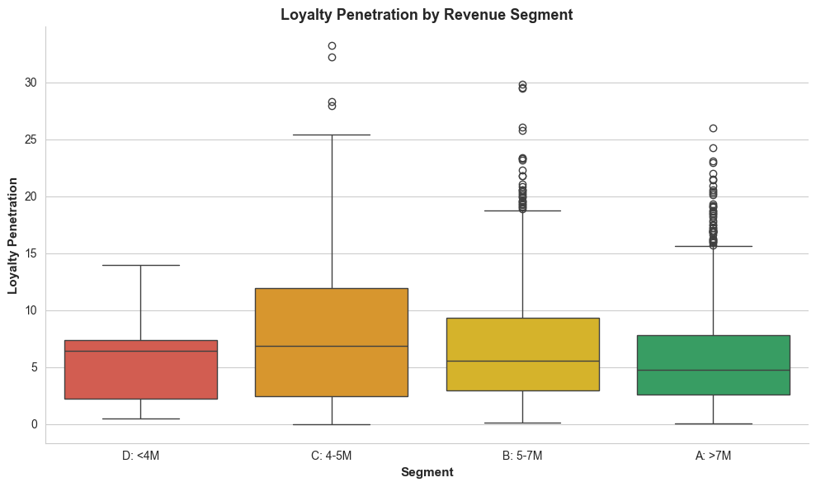
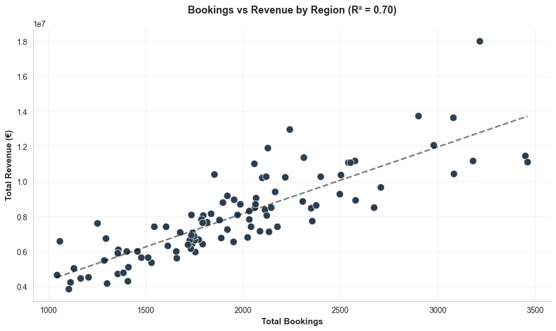
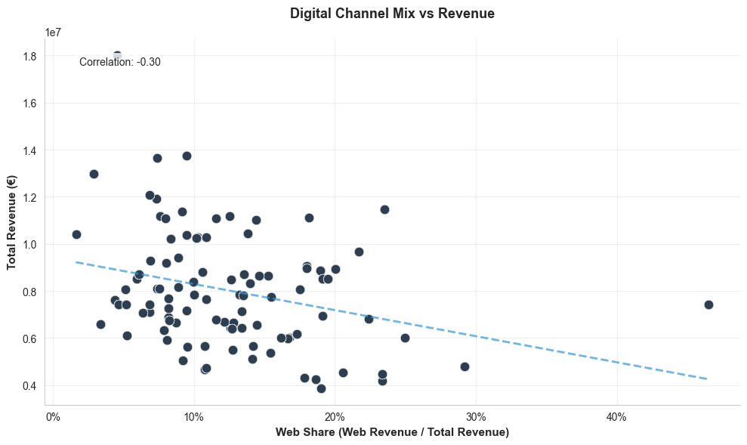
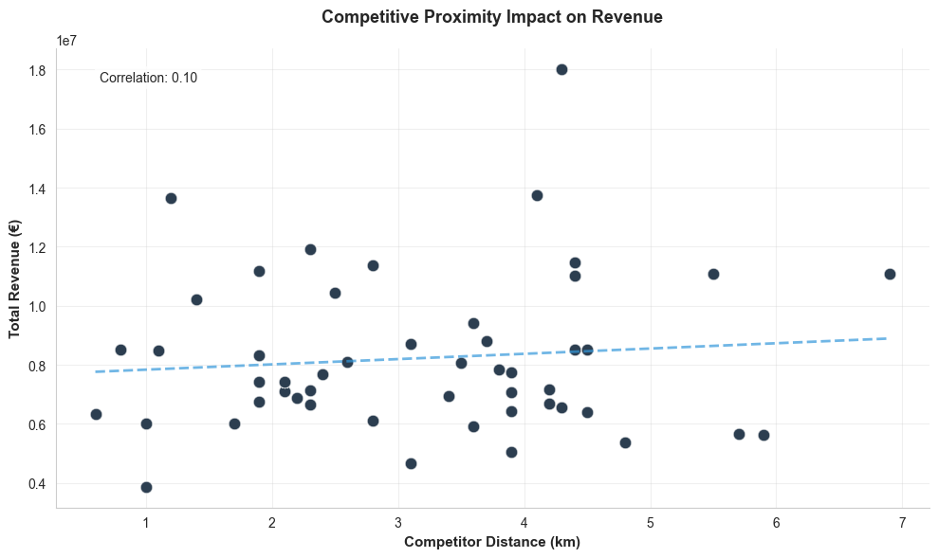
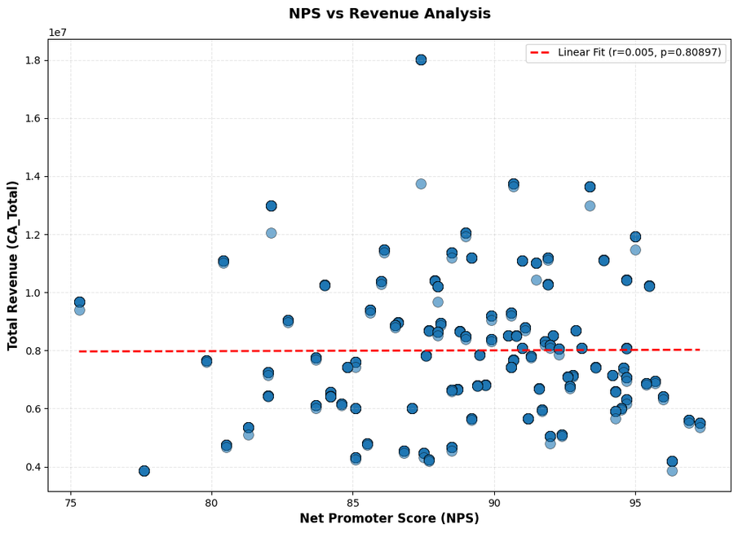
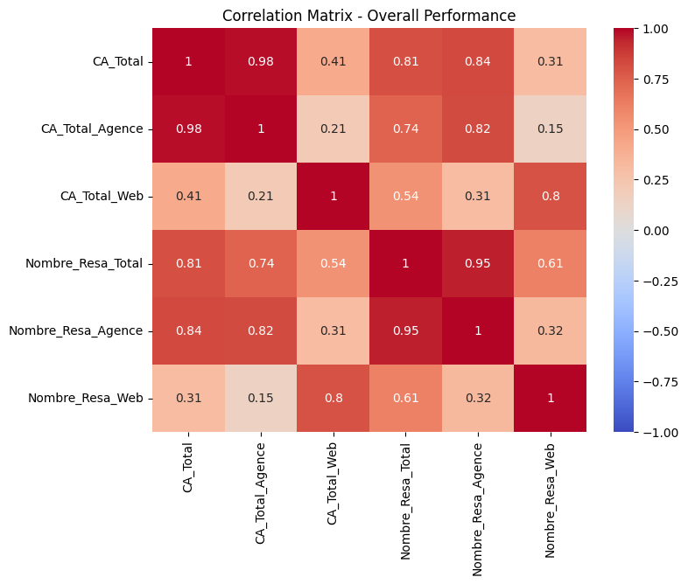
KEY PERFORMANCE DRIVERS
Implying that the most revenue is gained through bookings(prompting us to focus on all areas that push our bookings to boom)
NPS is also a driver;
Ofcourse if my customers are satisfied they will become loyal and keep on coming hence booming my bookings and revenue
Now seeing that our revenue depends on bookings, the top succeed due to loyal customer that keep on booking from them.
Keeping in mind what we just discovered, we want to keep on learning from our data
  .we looked at the competitive Impact
  Then the Digital channel mix
  We kept wondering why agencies are more correlated
From here we can be able to form clusters
and apply strategic recommendations

Slide 4
Segment-level strategies
Network-wide levers
Strategic Recommendations
Our recommendations operate on two levels.
Segment A — Champions
Objective: Scale what works
  Add advisor staffing during peak seasons.
  Publicize these “flagship agencies” in national campaigns.
  Pilot new premium travel products here first.
Segment D — Underperformers
Objective: Fix, focus, or consolidate
  Assess root causes: staff, visibility, catchment limits.
  Strong intervention: staffing replacement, retraining, store redesign.
  If unfixable → footprint rationalization
  Employee Travel Activation Program.
  digital lead generation
  Deploy seasonal in-store campaigns aligned with Carrefour promotions.
Segment C — At Risk
Objective: Rebuild traffic & trust
  Resolve customer experience issues (NPS-focused coaching).
  Aggressive visibility: stands at hypermarket entrance, mini travel fairs.
  Competitor counter-positioning in high-price battlegrounds.
Segment B — Growth Potential
Objective: Unlock latent demand
  Local hypermarket co-marketing campaigns.
  Loyalty reactivation targets (cardholder enrollments + referrals).
  Upskilling advisors on premium product selling.
Product
price
Place
Promotion

Slide 5
Not all agencies should be treated equally
Different clusters need different levers: quality, marketing, staffing, loyalty, digital, or footprint reconsideration.

